Slide 1
Voice Controlled Drone
Project Progress of ART TEAM

Slide 2
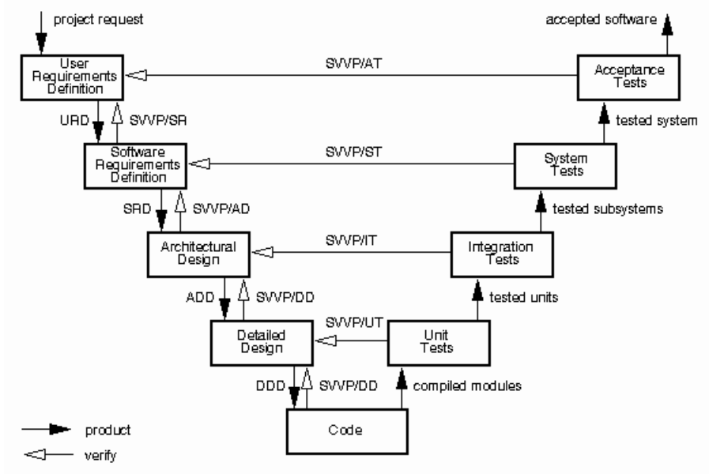
Methods ( V-Model )

Slide 3
Tools and Platform
Android Studio or Eclipse IDE
Sublime Text
Odroid U3
Android Phone

Slide 4
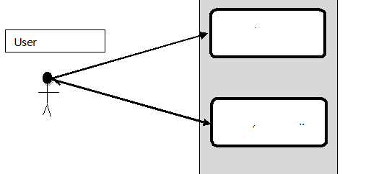
Case Diagram
Displaying Command
Voice Command

Slide 5
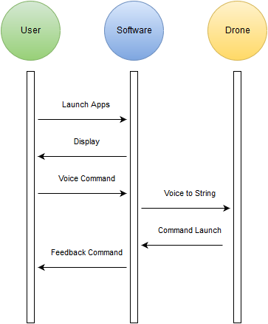
Sequence Diagram

Slide 6
Deployment Diagram

Slide 7
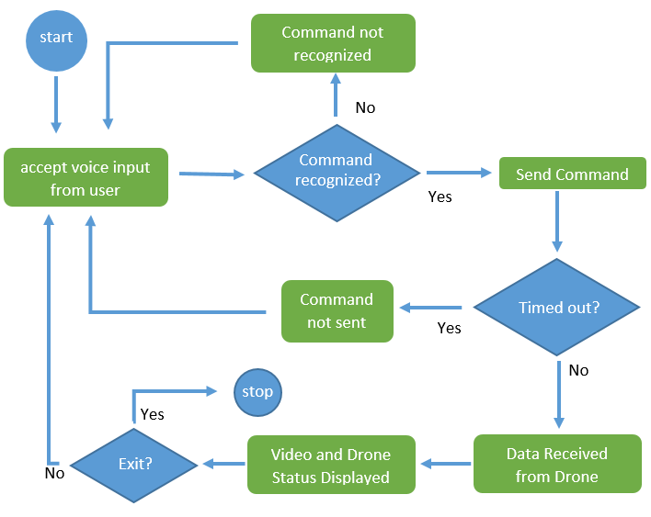
Activity Diagram

Slide 8
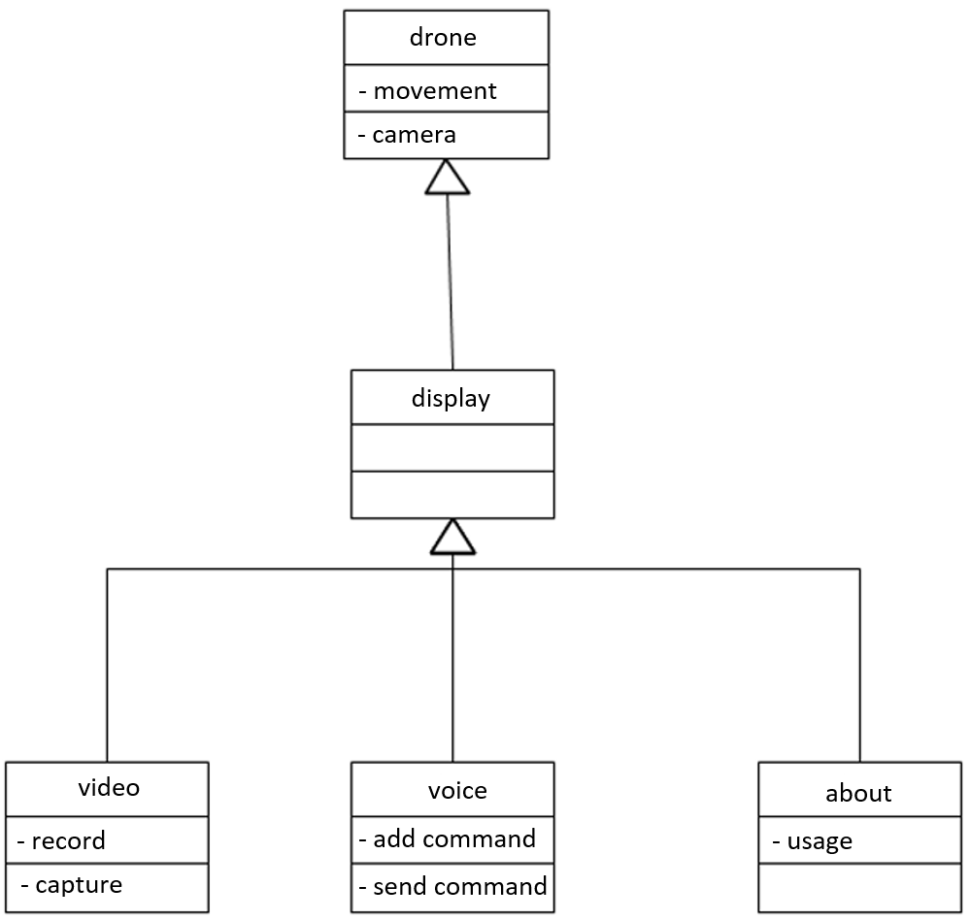
Class Diagram

Slide 9
First Implementation
Short range control using 2.4GHz Radio
Using command-line based, direct text instruction without voice recognition
Simple movement

